Slide 1
Fundamentals of Chemistry
AP Chemistry
Unit 1

Slide 2
Day 1: Basic Chemistry Concepts
Read: Pages 3-8, 27-31

Slide 3
I. The Study of Chemistry

Slide 4
I. The Study of Chemistry
Chemistry:

Slide 5
A. THE SCIENTIFIC METHOD
https://www.youtube.com/watch?v=_7sSuhQ1_24

Slide 6
Scientific Method
A way of solving problems
1. Make Observations
2. Formulate Hypothesis
3. Perform Experiments
Data:
Qualitative
Quantitative

Slide 7
Scientific Method
https://www.youtube.com/watch?v=k2MhMsLn9B0

Slide 8
B. Scientific Models
Theory (model)
Natural Law

Slide 9
II. Organization of Matter

Slide 10
A. Matter
Anything that takes up space and has mass
Mass:
Weight:

Slide 11
B. States of Matter
Solid
Liquid
Gas
Plasma

Slide 12
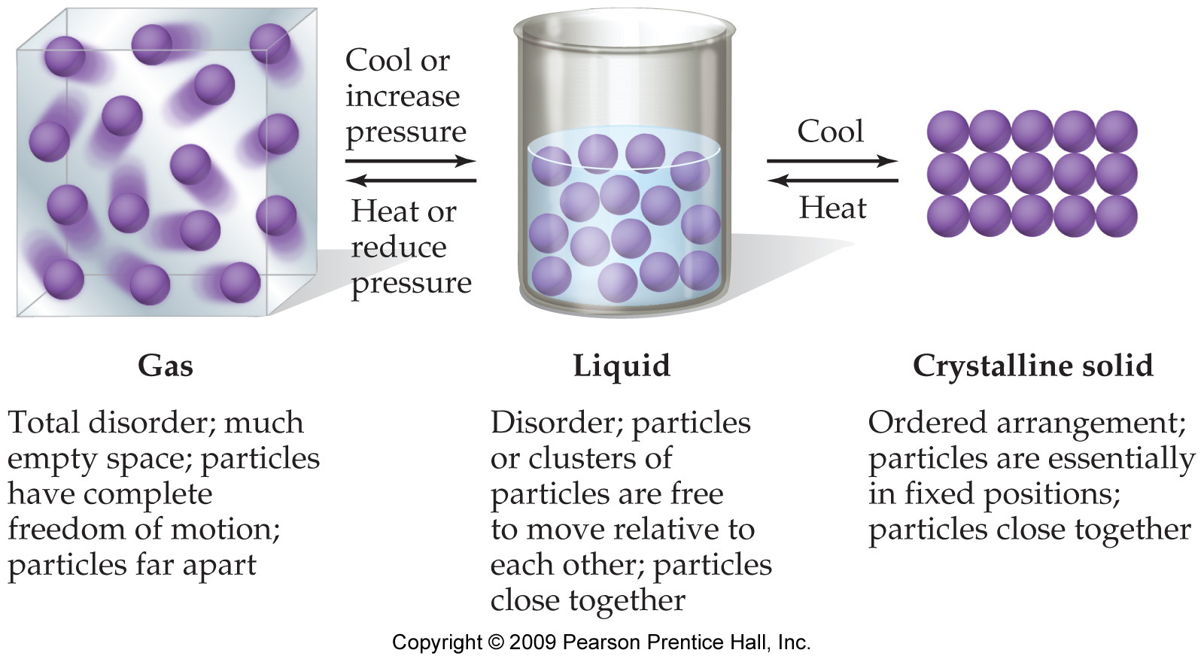
States of Matter

Slide 13
C. Classification of Matter
ATOMS --Smallest part of matter that maintains its chemical identity

Slide 14
1. Pure Substances
Elements
Compounds
Elements can’t be separated
Smallest part is an atom
Diatomics:
can be separated only by chemical reactions
Smallest part is a molecule

Slide 15
2. Mixtures: Physical Blend of Pure substances
Heterogeneous
Homogeneous
Blood
Soil
Salad
Granite
Air
Brass
Tea
Motor Oil

Slide 16
Solutions
Homogeneous Mixtures
Keep all properties of components
Can be separated by physical means
Concentration often represented in MOLARITY

Slide 17
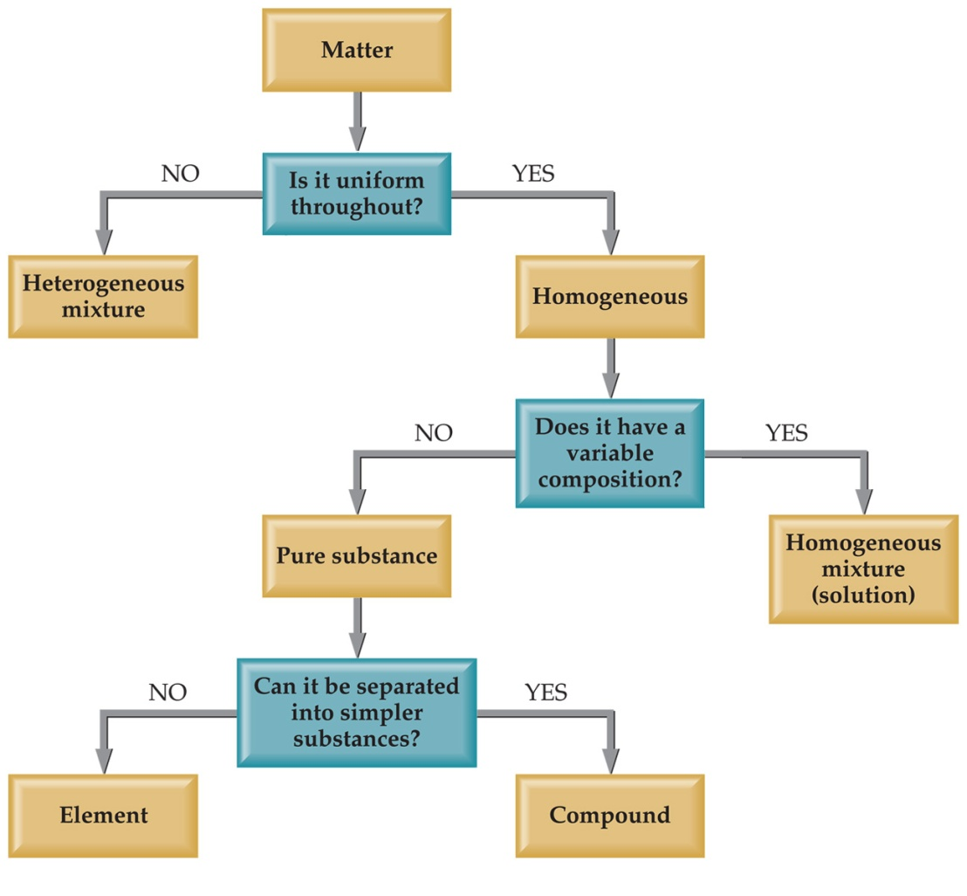
3. Flow Chart

Slide 18
3. Compound or Mixture
Compound
Mixture

Slide 19
4. Question: What is it?
Element, Compound or Mixture
Silver
Orange Juice
Ice Tea
Potassium Chloride
Oxygen
Air
Pine Tree

Slide 20
D. Separating mixtures

Slide 21
1. Filtration
In filtration solid substances are separated from liquids and solutions.
separate solids from liquids with a barrier

Slide 22
2. Distillation
Distillation uses differences in the boiling points of substances to separate a homogeneous mixture into its components.

Slide 23
3. Chromatography
This technique separates substances on the basis of differences in solubility in a solvent.

Slide 24
4. Electrolysis

Slide 25
III. Properties of Matter

Slide 26
A. Properties
Physical Properties
Color, solubility, odor, hardeness, density, melting point, boiling point, size, shape
Chemical Properties
Flammability, ability to react with acid

Slide 27
Properties
Intensive
Independent of the amount of substance present
Density, boiling point, color
Extensive
Dependent on the amount of substance present
Mass, volume, energy

Slide 28
B. Law of Constant Composition (Definite Proportions)
Elemental composition of a pure compound is always the same
Ex. Water is always H₂O; 88.8% O, 11.2% H; regardless of the method used to produce it, or where it comes from.

Slide 29
C. Law of Conservation of Mass
the total mass remains constant during a chemical reaction.​
Mass Reactant = Mass Product

Slide 30
IV. Changes in Matter

Slide 31
A. Types of Changes
Physical Changes
Changes of state, temperature, volume, etc
Boil, Freeze, Melt, Condense, Break, Split
Chemical Changes
Combustion, Oxidation, Decomposition, etc

Slide 32
B. Chemical Reactions
Chemical Reaction
One or more substances changes into a new substance

Slide 36
Evidence of a Chemical Reaction
Color Change
Energy absorbed or released
Gas or solid produced
Odor
Precipitate
Not easily reversed

Slide 37
Day 2 : Basic Chemistry Calculations
Read: 8-22

Slide 38
V. Units of Measurement

Slide 39
A. Nature of Measurement
Measurement is a quantitative observation consisting of two parts:

Slide 40
The Fundamental SI Units
Quantity | Name | Abbreviation
Mass
Length
Time
Temperature
Current
Amount

Slide 41
Metric Prefixes

Slide 42
Metric Conversion Examples
Convert 253.15 mK to K
Convert 1.32 km to mm
Convert 5.0 grams/mL to Kg/L

Slide 43
VI. Uncertainty of Measurement

Slide 44
A. Precision and Accuracy
Measurements are always inexact. Uncertainty always exists in measured qualities
Precision:
Accuracy:

Slide 45
B. Types of Error
Random Error
Systematic Error

Slide 46
C. Significant Figures
Measured quantities are generally reported in such a way that only the last digit is uncertain
Final answer should ALWAYS be reported with the correct number of sig figs

Slide 47
Sig Fig Rules
Rule
Example
EXACT Numbers: infinite number of sig figs

Slide 48
Significant Figures Practice

Slide 49
Rules of Significant Figures in Mathematical Operations
Multiplication and Division

Slide 50
Sig Fig Practice
Calculation Calculator Answer

Slide 51
Rules of Significant Figures in Mathematical Operations
Addition and subtraction

Slide 52
Sig Fig Practice
Calculation Calculator Answer

Slide 53
VII. Dimensional Analysis
Using Units to Solve Problems!!

Slide 54
A. Dimensional Analysis
Use conversion factors to change the units
Conversion factors = 1
1 foot = 12 inches (equivalence statement)
12 in ₌ ₁ ₌ 1 ft. 1 ft. 12 in
2 conversion factors
multiply by the one that will give you the correct units in your answer.

Slide 55
Examples
11 yards = 2 rod 40 rods = 1 furlong
8 furlongs = 1 mile
The Kentucky Derby race is 1.25 miles. How long is the race in rods, furlongs, meters, and kilometers?

Slide 56
11 yards = 2 rod 40 rods = 1 furlong
8 furlongs = 1 mile
A marathon race is 26 miles, 385 yards. What is this distance in rods and kilometers?

Slide 57
Units to a Power
How many m³ is 1500 cm³?

Slide 58
Units to a Power
How many cm² is 15 m²?
36 cm³ is how many mm³?

Slide 59
Using Two or More Conversion Factors​
Many times more than one conversion is necessary. Simply place them one after the other to get the units to cancel properly.​
Multiply number on the top and divide by every number on the bottom. ​
See Examples :1.7-10 on page 20-22

Slide 60
Multiple units
The speed limit is 65 mi/hr. What is this in m/s?
1 mile = 1760 yds
1 meter = 1.094 yds

Slide 61
More Examples if Needed

Slide 62
Multiple units
Lead has a density of 11.4 g/cm³. What is this in pounds per quart?
454 g = 1 lb
1 L = 1.094 qt

Slide 63
Day 3: Derived Units
Read: Pages 22-27

Slide 64
VIII. Density, Temperature and Volume

Slide 65
A. Density Basics
How heavy something is for its size.
The ratio of mass to volume for a substance.
D = M / V
units of g/cm³ or g/mL
Independent of how much of it you have
gold - high density air - low density.
See
Z: Ex 1.14 on p 26-27

Slide 66
Density Uses
Useful for identifying a compound
Useful for predicting weight

Slide 67
Floating
Lower density floats on higher density.
Ice is less dense than water.
Most wood is less dense than water.
Helium is less dense than air.
A ship is less dense than water.

Slide 68
Density of water
1 g of water is 1 mL of water.
density of water is 1 g/mL at 4ºC
otherwise it is less

Slide 69
Calculating
Units will be g/mL or g/cm³
A piece of wood has a mass of 11.2 g and a volume of 23 mL what is the density?

Slide 70
A piece of wood has a density of 0.93 g/mL and a volume of 23 mL what is the mass?

Slide 71
An empty container weighs 121.3 g. Filled with carbon tetrachloride (density 1.53 g/cm³ ) the container weighs 283.2 g. What is the volume of the container?

Slide 72
Density Problem
A 55.0 gal drum weighs 75.0 lbs. when empty. What will the total mass be when filled with ethanol? density 0.789 g/cm³
1 gal = 3.78 L 1 lb = 454 g

Slide 73
B. Temperature
A measure of the average kinetic energy
Different temperature scales, all are talking about the same height of mercury.

Slide 74
Temperature
Celsius and Kelvin scales are used. K is SI unit.
K=ºC+273.15​ ºC=(ºF-32)/1.8​ ºF=1.8(ºC) + 32​
See Example
Z: 1.11 and 1.12 on pages 24-25

Slide 75
Measuring Temperature
0ºC
Celsius scale.
water freezes at 0ºC
water boils at 100ºC
body temperature 37ºC
room temperature 20 - 25ºC

Slide 76
0ºC = 32ºF
0ºC
32ºF

Slide 77
0ºC is not 0ºF
ºF
9
5
ºC

Slide 78
(0,32)= (C₁,F₁)
ºF
ºC

Slide 79
(0,32) = (C₁,F₁)
(100,212) = (C₂,F₂)
ºF
ºC

Slide 80
Measuring Temperature
273 K
Kelvin starts at absolute zero (-273 º C)
degrees are the same size
C = K -273
K = C + 273
Kelvin is always bigger.
Kelvin can never be negative.

Slide 81
Temperature is different
from heat.
Temperature is which way heat will flow. (from hot to cold)
Heat is energy, ability to do work.
A drop of boiling water hurts,
kilogram of boiling water kills.

Slide 82
Units of heat are
calories or Joules
1 calorie is the amount of heat needed to raise the temperature of 1 gram of water by 1ºC.
A food Calorie is really a kilocalorie.
How much energy is absorbed to heat 15 grams of water by 25ºC.
1 calorie = 4.18 J

Slide 83
C. Volume
Volume of a cube = (length)³​
SI unit of volume is m³
1L=1dm³; 1mL=1cm³

Slide 84
Conversions Involving Volume
Any derived unit can be used as a conversion factor between the units that are present. ​
When converting volume using derived units (cm³ to in³) numbers need to be multiplied out also, cubed in this case. ​
Make sure appropriate sig figs are used.

